Slide 1

WSU GLOBAL Student Housing Analysis: A Data-Informed Living Solutions Initiative
By UDEME EKANEM, JUSTIN KALIKAWE

Slide 2

Table Of Contents
Introduction
Purpose of the Analysis
Dataset Description and Relevance Findings and Recommendations
Data Cleaning and Preprocessing
Description of Columns Used
Exploratory Data Analysis (EDA)
Simple Linear Regression Analysis
Analysis of Additional Factors
Conclusion
Appendices

Slide 3

Introduction
This project aims to analyze housing satisfaction among international students at Wichita State University (WSU). Importance of Suitable Housing for International Students
It focuses on understanding the key factors influencing students' housing choices and satisfaction.
Insights gathered will contribute significantly to enhancing the living experience of WSU's diverse international student body.

Slide 4

Purpose of the Analysis
The primary goal is to conduct a detailed study of housing satisfaction among WSU's international students.
Examine factors like rent, residence type, safety perception, and duration of stay in Wichita.
Findings will aid in developing a dedicated website to assist students in finding suitable housing, enhancing their overall WSU experience.

Slide 5
Dataset Description and Relevance
Dataset compiled from a comprehensive survey filled out by WSU's international students, focusing on their housing situations.
Includes variables such as monthly rent, satisfaction levels, type of residence, safety perceptions, and stay duration.
This real-life snapshot is crucial for developing a user-centric housing information platform.

Slide 6

Data Cleaning and Preprocessing
Data cleaning involved selecting relevant columns for an accurate analysis.
Handled missing or incomplete data, especially in key columns like rent and satisfaction levels.
Converted data to appropriate formats for ease of quantitative analysis.

Slide 7

Description of Columns Used
Monthly Rent: Insight into housing affordability and options.
Overall Satisfaction: Measures contentment with current living conditions.
Type of Residence: Differentiates between apartments and houses.
Safety Perceptions: Indicates the role of safety in housing satisfaction.
Duration in Wichita: Assesses if stay duration affects housing satisfaction.

Slide 8

Exploratory Data Analysis (EDA)
Initial EDA provided insights into the distribution and characteristics of the dataset.
Identified general trends and patterns, laying groundwork for detailed analysis.

Slide 9
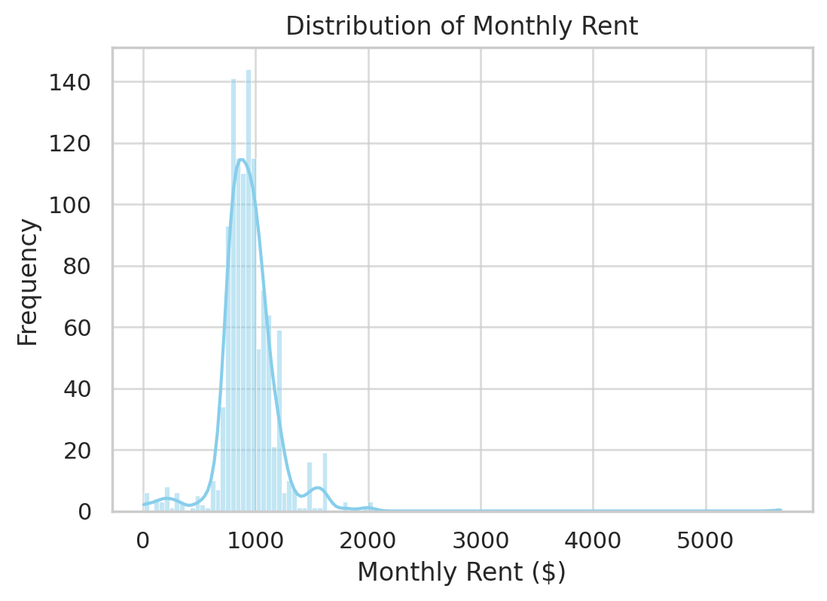
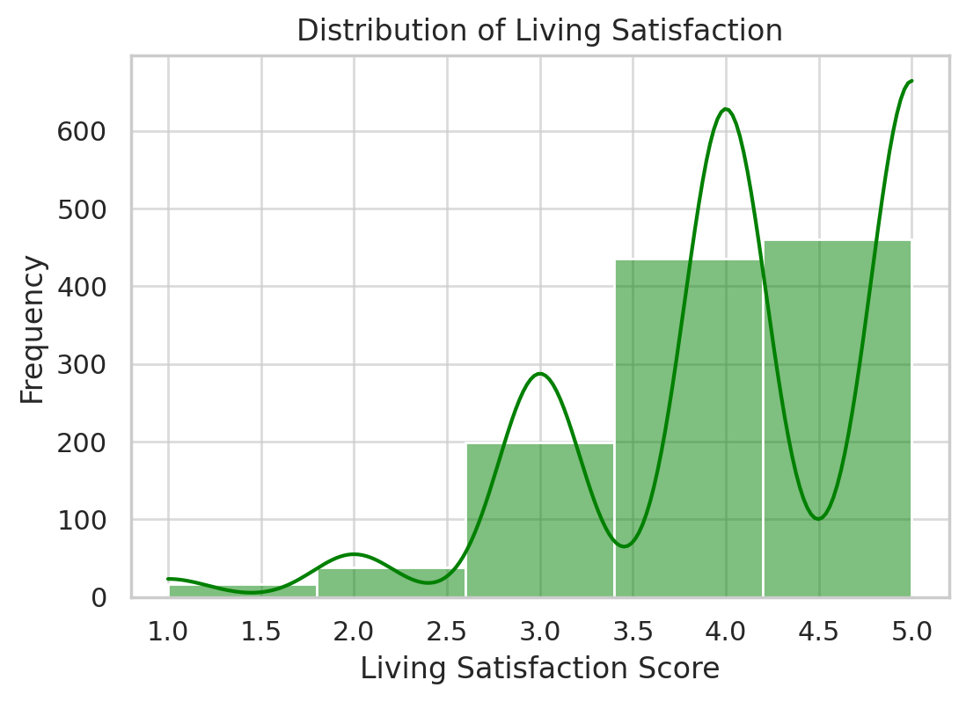
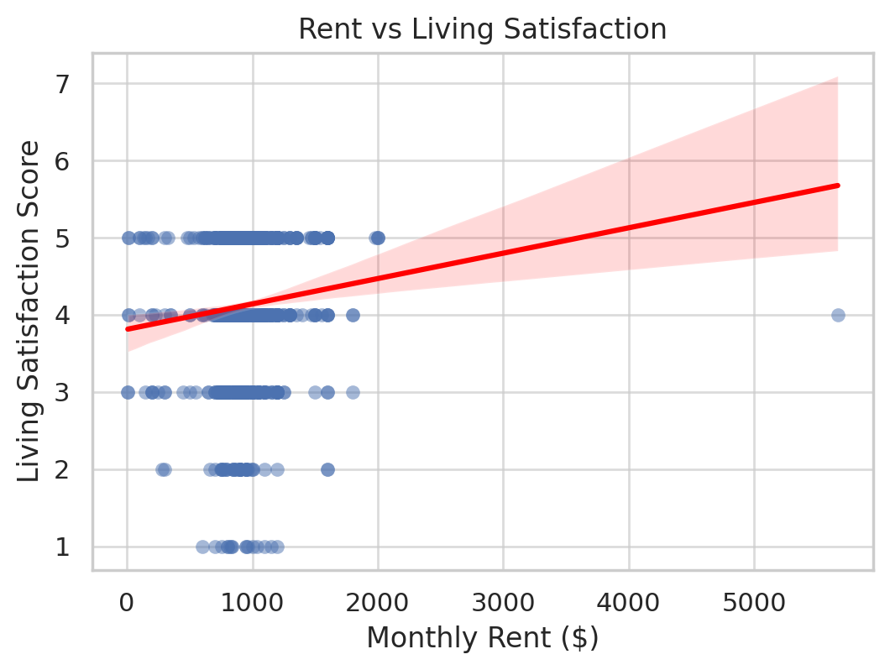
Visualizations of Findings from Analysis

Slide 10
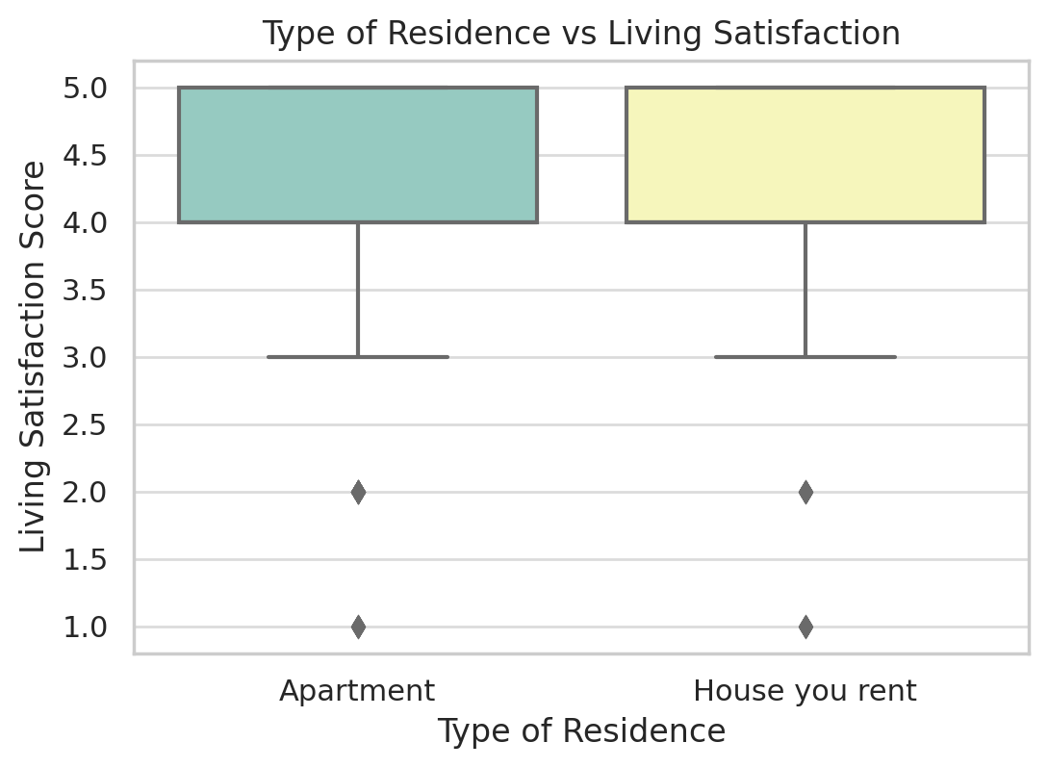
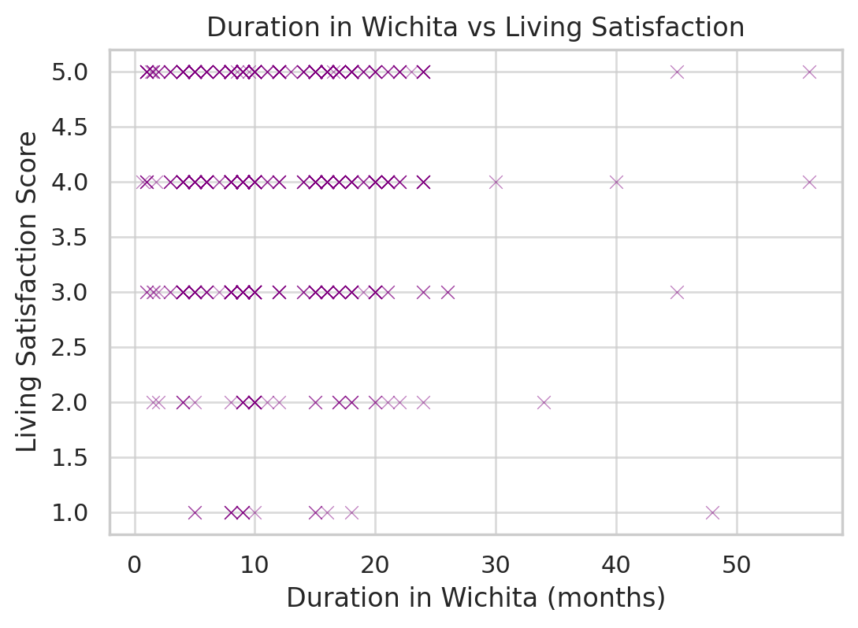
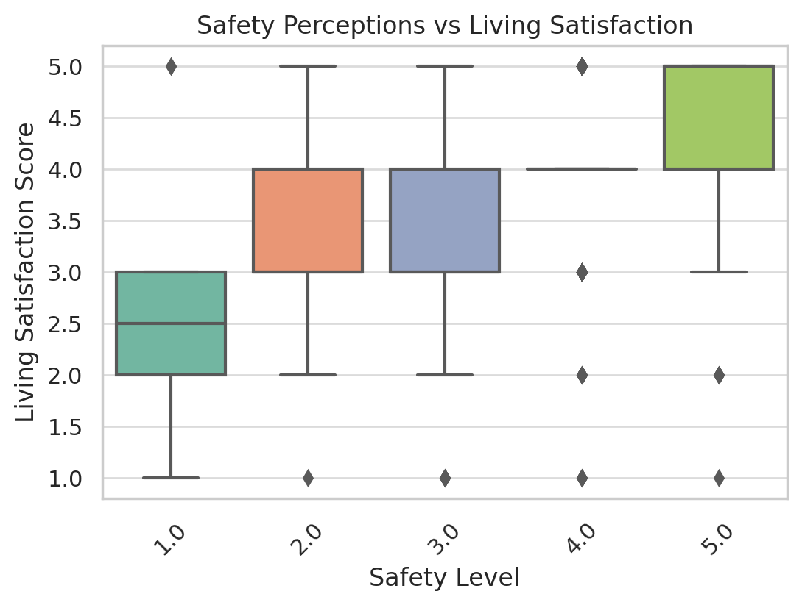
Findings Cont’d.

Slide 11
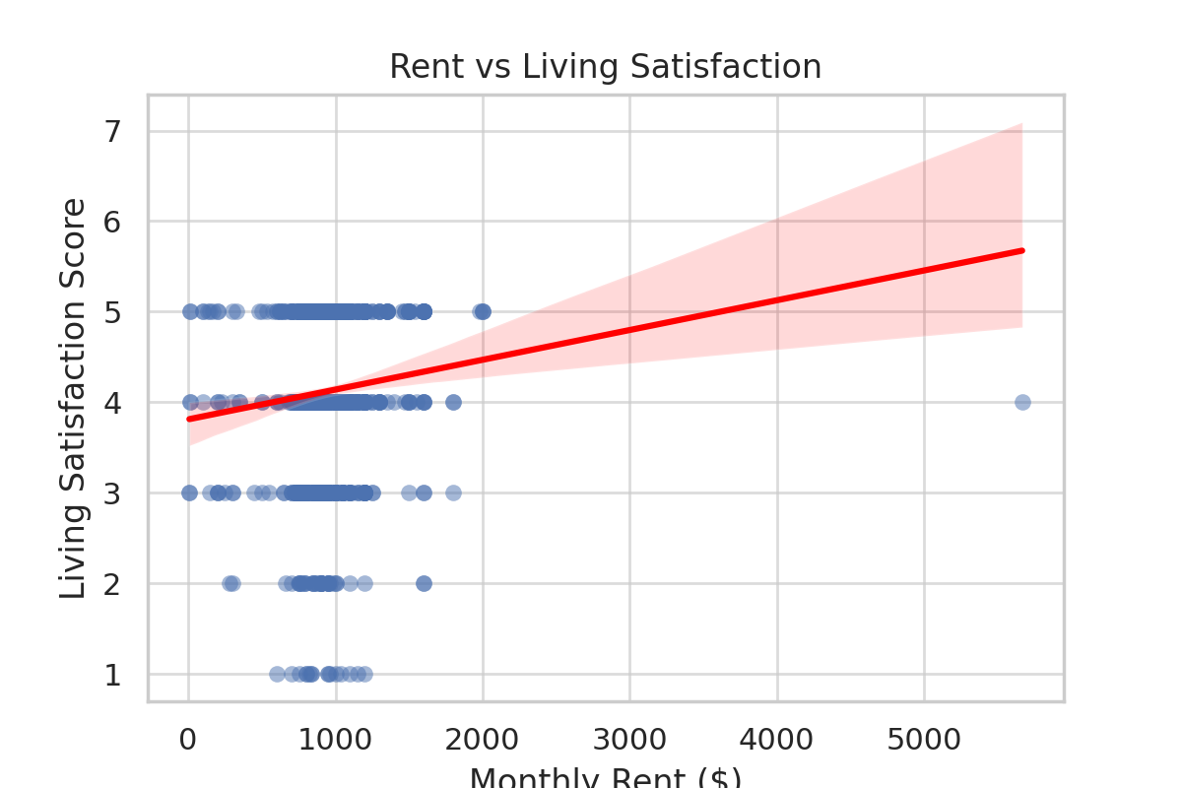
Simple Linear Regression Analysis
Employed a simple linear regression model to explore the relationship between monthly rent and living satisfaction.
Findings showed a minimal positive correlation between rent and satisfaction, but with a low R-squared value, indicating other factors are more influential.

Slide 12
Analysis of Additional Factors
Safety perceptions strongly correlate with living satisfaction, underscoring its importance in housing decisions.
Type of residence (apartment vs. house) also significantly influences satisfaction levels.
No significant correlation found between duration in Wichita and housing satisfaction.

Slide 13
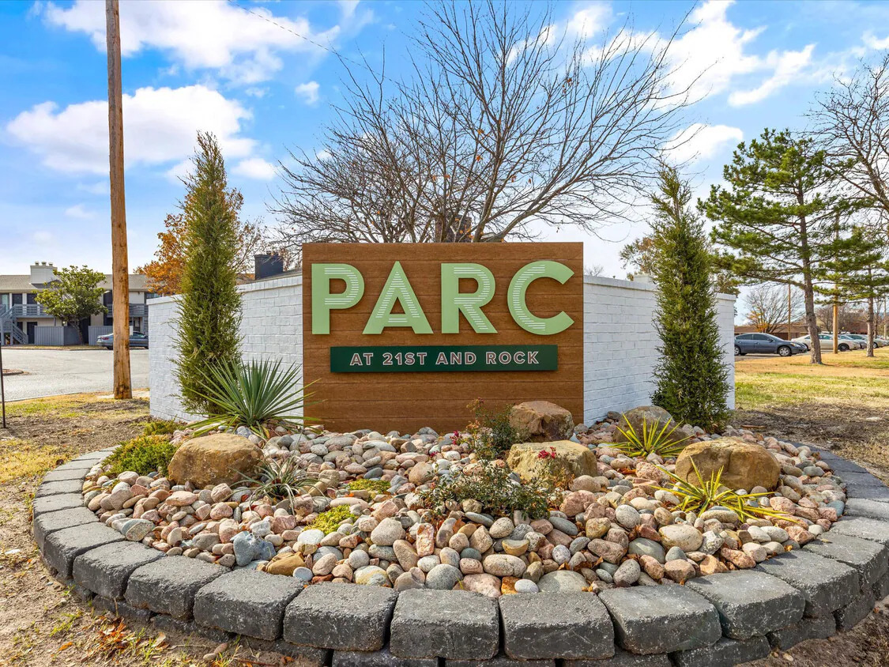

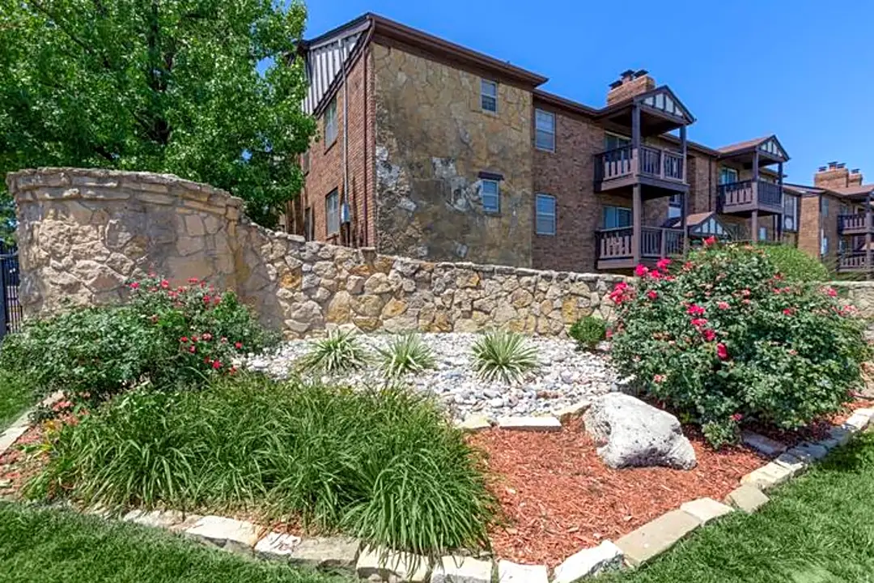

Housing Recommendations based on Findings
Based on Research findings, the best criteria to focus on in terms of finding satisfactory apartments for the website is general safety. Some examples of apartments with this consideration include:
Parc At 21st
Seventeenth
Brickstone
Tall Oaks

Slide 14

Conclusion
Key findings indicate that while rent is a factor, safety perceptions and type of residence are more influential in housing satisfaction.
Recommendations for the housing website: Focus on safety, type of residence, and a user-friendly interface with customizable filters.
These insights are crucial for developing a resource that truly meets the needs of international students at WSU.

Slide 15

Appendices
Exploratory Data Analysis | US EPA, www.epa.gov/caddis-vol4/exploratory-data-analysis. Accessed 11 Dec. 2023.
“What Is Exploratory Data Analysis?” IBM, www.ibm.com/topics/exploratory-data-analysis. Accessed 10 Dec. 2023.

Slide 16

Authors
Udeme Ekanem WSU ID: E578C949
Justin Kalikawe WSU ID: G959P526

